Slide 1

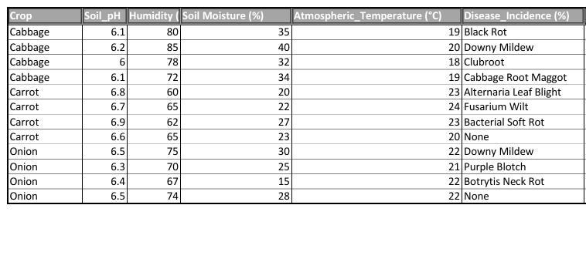
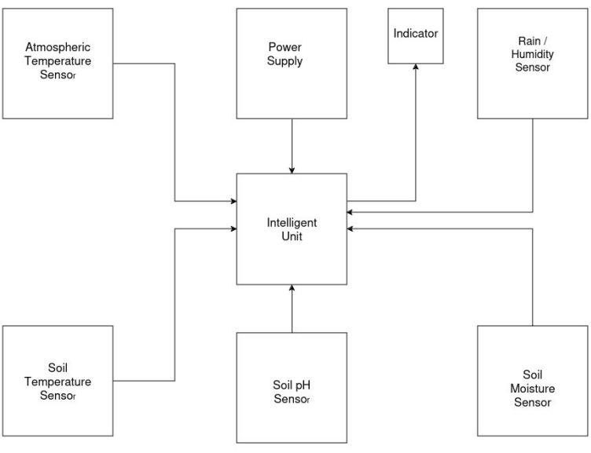
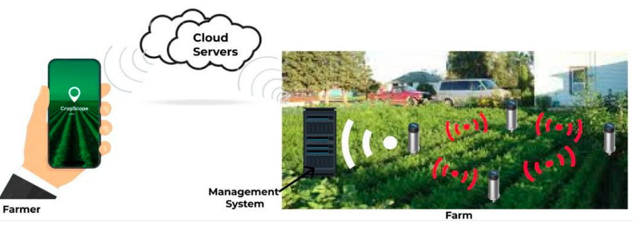



ALLOCATION OF SENSORS TO MONITOR VITAL SOIL AND ATMOSPHERIC FACTORS THAT AFFECT PLANT GROWTH
KNUST
A. J. Amoah ¹ S. N. A. Bonney ¹ I. N. L. Lawson¹
* peadjei.coe@knust.edu.gh
¹ Department of Computer Engineering, College of Engineering Kwame Nkrumah University of Science and Technology (KNUST), Ghana
D. U. Akaya^{*1}
www.knust.edu.gh
INTRODUCTION
Unpredictable weather patterns and ineffective resource management pose problems for agricultural sustainability and productivity.
By implementing sensor nodes to track soil pH, moisture, humidity, and air temperature, this project presents an Internet of Things-based agricultural monitoring system to address these problems.
Farmers can receive actionable insights from the mesh network formed by the collected data, which is transmitted to Google Cloud Platform for sophisticated analytics and machine learning.
Farm conditions, statistics, and alarms are available in real-time through an easy-to-use mobile app. This method, which represents important developments in precision agriculture, attempts to maximize farming operations, raise crop yields, and encourage sustainable practices.
Fig. 2: The dependency of some crop diseases on atmospheric and soil conditions
Through the use of advanced analytics and the monitoring of important environmental factors, this study seeks to increase agricultural sustainability and productivity by implementing an Internet of Things-based farm monitoring system.
DISCUSSION
The goal of the project was to monitor important environmental factors for onions, cabbages, and carrots using an Internet of Things-based system in order to increase agricultural productivity and sustainability.
Results verified that temperature, soil pH, humidity, and soil moisture all affect crop diseases.
These findings support earlier study while also offering the benefit of real-time data for prompt decision-making.
Potential problems in sensor calibration and the narrow emphasis on just three crop kinds are limitations.
The findings validate the vital role that environmental monitoring plays in crop health management and yield optimization.
To confirm the system's efficacy even more, future studies could examine a wider range of crops and environmental conditions.
METHODS
The project monitors soil and atmospheric parameters influencing plant, specifically cabbage, carrots, and onion crop development, using an Internet of Things-based methodology. Sensor deployment, data gathering, network communication, and data analysis are all included in the process.
The farm is equipped with sensors that are used to continuously collect data on soil moisture, pH, temperature, and humidity.
To provide dependable data transfer to a MQTT broker, which connects to cloud services, sensors create a mesh network.
A smartphone app for real-time farm monitoring and alarms provides insights from data analysis done on Google Cloud Platform.
Fig. 1: Methodology Figure
CONCLUSION
Summary of your key conclusions. Recapitulate the main findings and the implications of the research for theory and practice. It could go along those lines: In conclusion, this study highlights the importance of X in understanding Y and provides a foundation for future research in this area. The findings suggest that X has a significant effect on and that this effect may be mediated by [explain possible mechanisms]. The study has some limitations, but the implications of the findings are significant for clinical practice and public health policy. Overall, this study contributes to the knowledge base in the field and may pave the way for further discoveries.
REFERENCES
Lefteris Benos, Aristotelis C Tagarakis, Georgios Dolias, Remigio Berruto, Dimitrios Kateris, and Dionysis Bochtis. Machine learning in agriculture: A comprehensive updated review. Sensors, 21(11):3758, 2021.
Ania Cravero and Samuel Sepúlveda. Use and adaptations of machine learning in big data—applications in real cases in agriculture. Electronics, 10(5):552, 2021.
Procedure: Throughout the farm, sensors were placed in strategic locations, calibrated to yield precise readings, and data on soil moisture, pH, humidity, and air temperature was collected every 15 minutes.
Data analysis: The findings of the analysis of the collected data were displayed through graphs and charts in a mobile app for real-time insights and warnings. The analysis was conducted on Google Cloud Platform utilizing statistical techniques and machine learning models.
RESULTS
The study discovered that some environmental conditions had an impact on certain crop diseases. Disease incidence was directly correlated with changes in temperature, soil pH, humidity, and moisture content for carrots, onions, and cabbages. The hypothesis under investigation was validated, indicating that keeping an eye on these metrics can yield important information about managing diseases and enhancing crop health.
The figure below shows how some crop infections depend on the measured atmospheric and soil variables
Mirza Golam Kibria, Kien Nguyen, Gabriel Porto Villardi, Ou Zhao, Kentaro Ishizu, and Fumihide Kojima. Big data analytics, machine learning, and artificial intelligence in next-generation wireless networks. IEEE access, 6:32328–32338, 2018.
Felix Antonio Rego Rodríguez, Lucía Germán Flores, and AdriánAlejandro Vitón-Castillo. Artificial intelligence and machine learning: present and future applications in health sciences. In Seminars in Medical Writing and Education, volume 1, pages 9–9, 2022.
Claude E. Shannon. A mathematical theory of communication. Bell System Technical Journal, 27(3):379–423, 1948.
mail: compeng@knust.edu.gh
Department of Computer Engineering Technology Week - TWeek 2024
compengknust

